Slide 1
Resident satisfaction Analysis
Capstone project FOR Katz school data analytics and visualization and md squared property group
PROGRAM INSTUCTOR: ANDY CATLIN
COMPANY SUPERVISOR: ABBY MINTZ
PROGRAM ANALYST; QINGHAO(RANDY) XIA

Slide 2
Back ground
MD Squared Property Group is a New York based property management company
Top Management is interested on:
1. Improve professionalism of property managers
II. Request satisfaction rate of tenants
The outcome of the program are:
I. A survey questionnaire
II. A satisfaction analysis report

Slide 3
The steps of the project
Arrange an interview with company management
1. State scope of the project
2. Gain access to the database
Start an environment scan
1. Study the property management business in New York
2. Study the how to design a survey
Design a survey and send out to targeted population
Acquire the result and work on data analysis
1. Exploratory data analysis
2. Logistic Regression analysis
Draw conclusions and report the outcome

Slide 4
Arrange an interview with company management
Scope of Work
1. Context: Rapid Expansion VS. High-quality Service
2. Vision: Increasing in tenant’s satisfaction
Gain access to the database
1. Export from RIS system
2. Excel Power Query server, and Spreadsheet

Slide 5
Environment Scan
Understand following characters should be used as factor to evaluate tenant’s satisfaction
1. Availability
2. Friendliness
3. Communication
4. Responsiveness
5. Problem resolution

Slide 6
Design a survey and send out to targeted population
Total of 1,574 tenants involved
84 buildings involved
Two Companies involved
13 property managers, and 8 assistant property managers involved

Slide 7
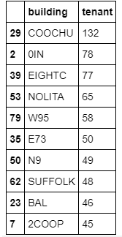
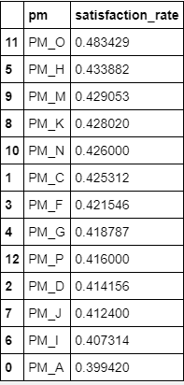
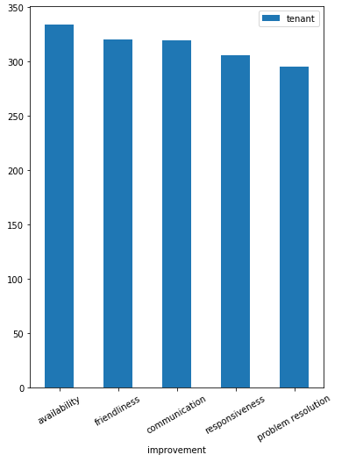
Exploratory Data Analysis
The average satisfaction rate is about 41.8%
The highest satisfaction rate is 77.6%, and the lowest is 3.2%
Other Insights

Slide 8
Logistic Regression Analysis
The sample size is including 11 tenants
The communication could be a good predictor
The ease of contact (availability)could be a good predictor
The follow up (problem resolution)could be a good predictor
The responsiveness and consideration (friendliness) are not good predictors
Validation Set and Cross-Validation are used to verify the accuracy of the model

Slide 9
Questions?

Slide 10
Thank You!!!

